Slide 1
The Evolution of Data Science – and why you should care
Jennifer Lewis Priestley, Ph.D.
Kennesaw State University

Slide 2
Notes:
INTRO: Ten years ago, we didn’t know the term data science…but today its ubiquitous…
Montage of headlines
Google Trends (with Kim Kardashian overlay)

Slide 4
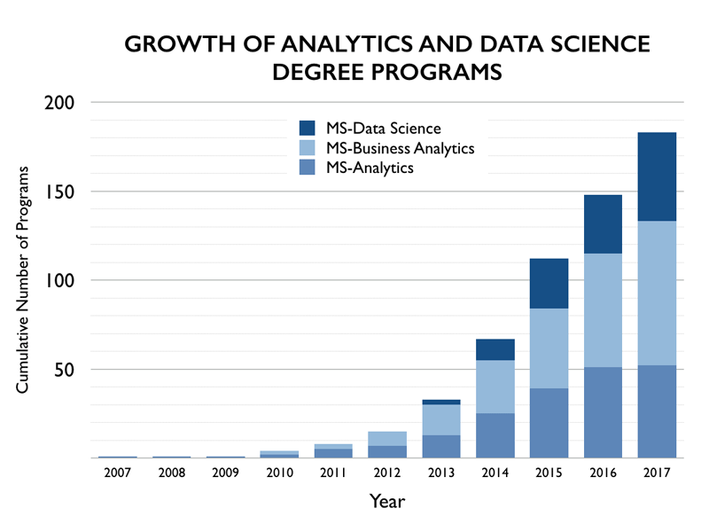

Slide 5
How the Data Ecosystem is Evolving…
Massive, Integrated and Dynamic
Artificial Intelligence
Deep Networks
Large, Unstructured and In Motion
Support Vector Machines
Machine Learning
Sensor-based/IoT
Small, Structured and Static
Classification
Predictive Modeling
Descriptive Statistics
Notes:
SLIDE: This has been a function of decreased costs of storage, increased computing power contributing to the datafication of the global economy…
Note from JLP: I am trying to demonstrate in these two slides what is driving the “datafication”…and how the skills needed are different.
Note from RJM: Should we take this further? One of the things that seems to be coming are dynamic systems (manufacturing or health care…models to attempt to map the vastness of complex interactions within an ecosystem). This may be what you mean in integrated, but it seems to push forward through any one method to multiple combined methods.

Slide 6
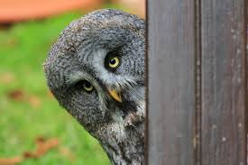
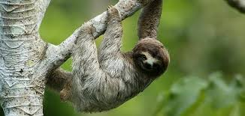
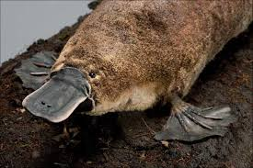

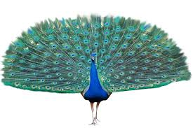
The Rise of a New Discipline
Disclaimer: Any likeness to actual academic departments is unintentional (sort of)

Slide 7
The Rise of a New Discipline
…and a new approach to knowledge creation
Notes:
The key message in this slide is to communicate the need for interdisciplinary contribution to new knowledge creation.

Slide 8
The Rise of a New Discipline
…changing universities for the better
 | Traditional Orientation
Research Funding | Public Sector
Degrees | Single Siloed Department
Publication | Single Author
Notes:
SLIDE: Universities that have embraced this data science as a discipline have also seen the development of a whole new approach to the way they engage the private sector…
NOTE from JLP: You had indicated that a discussion of each of these rows would need to include data…I was not sure what you were referencing. The next two slides are intended to be related to this one.

Slide 9
The Rise of a New Discipline
…changing universities for the better
 | Traditional Orientation | Data Science-Centric Orientation
Research Funding | Public Sector | Private Sector
Degrees | Single Siloed Department | Interdisciplinary
Publication | Single Author | Multiple Authors

Slide 10

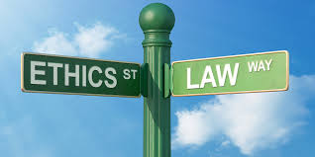
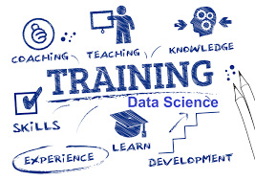
What’s Next?

Slide 11
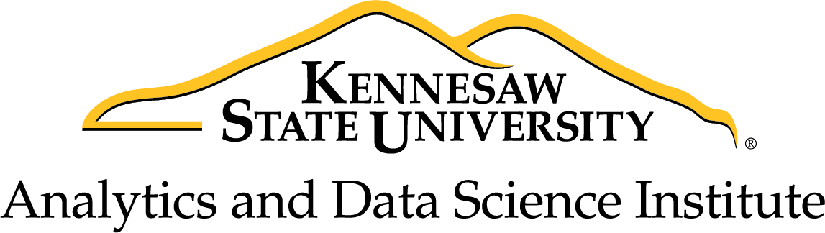
datascience.kennesaw.edu

